Slide 1
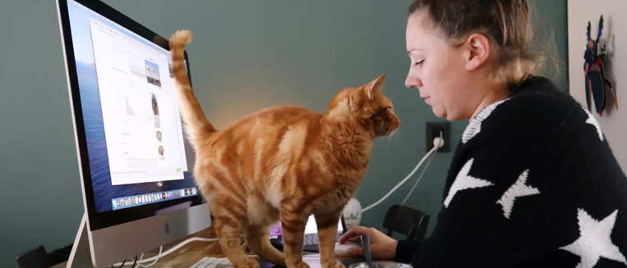
COVID-19 Sent you home now what?
Image: REUTERS/Eva Plevier
Notes:
Rosalind will take this slide and move us into the next one
The era of interruptions- animals, kids, the fedex delivery…
How did this rock our world

Slide 2
Who are we
Rosalind Radcliffe
IBM Distinguished Engineer, Chief Architect for DevOps for Enterprise Systems
rradclif@us.ibm.com
@RosalindRad
Jennifer Velasquez
WW DevOps Leader for Enterprise Systems
jen@us.ibm.com
Notes:
Rosalind will introduce myself... short into.. Then your turn

Slide 3



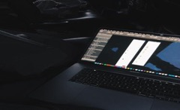
What we did before COVID- 19
Travel
Face to face
Collaboration
Full Day
Notes:
Jen starts this page,
Value stream assessments are most effective when there is transparency on the current state and collaboration defining a future state.
Both key off that of trust.
The old ways of getting there quickly:
Locked in room
Easy to see who was checked in and who wasn’t
Able to identify leaders and those who embrace change, those who oppose
Able to read body language
Perfect for driving a collaborative session.
Requirements:
Lots of whiteboard
Establishing trust early
Getting the right folks in the room… and getting the right folks driving the discussion
Capitalize on the energies in short order, turn around of recommendations
We basically had, while we didn’t know it at the time, a luxury – a way to get a group of people together to collaborative work and create a goal – a target state.
Rosalind – Add story – introduction of people who did not know each other, catartic experience

Slide 4
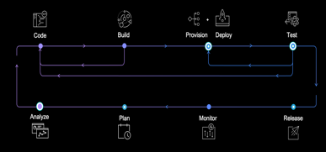
The Challenge How to do day long workshops to walk through the value stream without being able to get together for a full day in a room.
Notes:
Rosalind run this page – it willl be short
Our senses were no longer of value. No read of participants. No visual for comprehension or validation of understanding. No casual time to get to know the audience before the workshop begins.
No travel
No conf room
No eye to eye contact
No reading of body language
What were we going to do to come close to the experience – personable, engaged, collaborative, team building, establishing trust

Slide 5
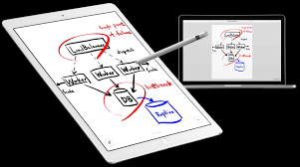
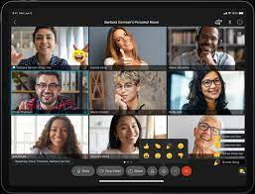
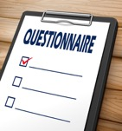
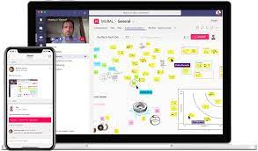


What tools to use?
Input
Questionnaires
Tools
Video
Post or collaborate
Raw or PPT
Yes or No
Notes:
Jen you start -
Input –
Moving from Whiteboard free script to something that would translate in a virtual environment became the task.
And to really tighten the pressure in our case, we had 3 assessments already scheduled that had to be transitioned to something new in short order.
Considerations:
Webex – ppt, like we are doing right now… but… that doesn’t really drive collaboration if the audience isn’t engaged (strike one)
Questionnaires – get info upfront… but…. Getting the info is how you get the team to engage which would have been counterproductive to our needs, It also may undermine building the trust established by the engagement of speech. (strike two)
So how can we drive collaboration:
Lots of collaboration tools like Mural where outside participants can work in real time with each other ….. Depending on the amount of data you need to get through, maybe this an answer. BUT we had volumes to do in short amount of time, not going to address our needs.
The whiteboard is critical piece to this effort so we have to find a way to recreate that experience.
The search begins…
Webex whiteboard – response time didn’t fuel collaboration…afraid we might drive frustration vs collaboration
Easiest way our team found to whiteboard was with an IPAD and pencil… but what app? What were the requirements?
To have a whiteboard session we needed:
Infinite whiteboard… you never know how much information is going to be shared
The whiteboard would be used by the facilitator and shared with the audience as a way to recreate that single conference room
The whiteboard had to be responsive – latency will likely result in folks doing other things. We have to keep a pace going to keep the interest of the group.
The whiteboard needed to be able to be SAVED!
We needed a way to print out the whiteboard or share the result with the group
We needed colors – who likes a meeting were everything is in the same color!
Our first attempt, and ipad app that allowed you to add pages at will
The good: it allowed us on the fly to add a new page and start a new topic. It also provided a way to create a pdf. (OH – and for those wondering, this was another consideration – where was the information stored and what was required to print… You have to consider confidentiality and MANY apps were dropped from the list due to this)
The Bad: What if the topic was bigger than a page! Yikes! What if you need to navigate back to confirm something… you are paging back one by one through 10 pages or more? Something to consider.
Well this proved painful so off to tuning our requirements. We need easy navigation
After a few more trials we settled in on Mural.
We stuck with the facilitator scribe vs the collaboration of participants to avoid training participants on mural, time management,
It persisted post the workshop so we could leverage in additional sessions with the client as well as in producing a list of recommendations. This area is still under investigation. We have leverage Mural to visually reconnect the audience to the discussions, we have infused our PPT recommendations into the mural so we could leverage a blend of the experiences…
For me personally, I think when we get to a primary direction of communication, a ppt works best with the “history” available when we need to resort back to that more balanced dialog. … jury is still out.
Rosalind – move to add to anything for tools, then move to video
So finally, video. Yes, we discuss with clients ahead of time the use of video to help in driving that connection. You can’t replace what you get from being in one room… but the next best thing is to at least know if someone is checked in or out. Move from reading body language to facial responses. Also to use your own visual to create energy and show you are checked in
Standing desk – have to be able to like working in the session

Slide 6






What’s the right format?
3 Hour format
Restructure approach from one day to a series
Bridge discussions between sessions
No preset order after first session
Session value
Manage participation across multiple sessions
Progress at an acceptable speed for client
Building content for end goal
Stay focused and drive schedule
Can we keep an audience engaged and on webex for 6+ hours?
Can we condense 6 hours of intense work into something smaller?
Will the move from real whiteboard and conference room to virtual impact time need?
Day 1
Business context
Current Understanding
Day 2-N
Deep Dive into areas
REPORT
Notes:
Rosalind start
What we can't do
New format
Jen
Manage participation, progress – ie keep moving, reminding of missing parts – background slack
And transition
And report

Slide 7
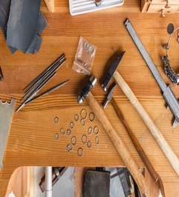
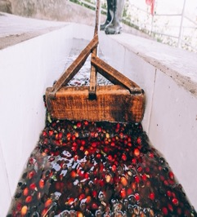

In Summary
It’s…
Wait for it….
People Process and Tools!
Virtual format of delivery requires:
the right tools
the right process
And success depends on the ability to engage the people
Virtual or face-to-face,
the result is a reflection of engaging the right people in the right conversations
Notes:
Jen starts
Shorter time slots – webex/zoom fatigue
Focused areas - can’t do full lifecycle across all platforms
Bridge series across sessions
Match aptitude of audience
Balance view with desire to take action
Rosalind closes

Slide 8
What we want to learn?
Do you have other ideas that have worked for facilitating virtual workshops?
Do you have other ideas that have worked well for virtual workshops?
Are there any tools that work for everyone?
Process
Tools
Notes:
Rosalind starts
We have learned a lot, but it's not over, the new normal will end up with virtual and face to face
Looking for suggestions from others that have done this and have additional ideas – suggestions
Jen Ends
Thank you for your time
Glad to have an opportunity to speak DOES,
Enjoyed attending in the past
Looking forward to the next live event

